Slide 1
Frames and Co-ordinates
PDE4431 Industrial Manipulators
Judhi Prasetyo & Bittu Scaria
Middlesex University Dubai

Slide 2
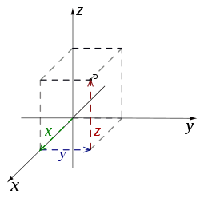
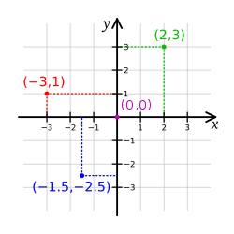
Common co-ordinate systems
Number line
Cartesian coordinate system

Slide 3
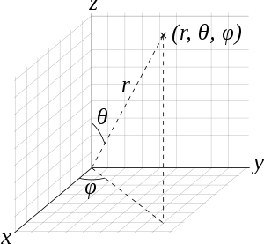
Co-ordinate Systems
In geometry, a coordinate system is a system that uses one or more numbers, or coordinates, to uniquely determine the position of the points

Slide 4
Polar coordinate system
Cylindrical and spherical coordinate systems
Orientation-based coordinates

Slide 5
Configuration Space
Recollecting
A robot is mechanically constructed by connecting a set of bodies, called links, to each other using various types of joints.
Actuators, such as electric motors, deliver forces or torques that cause the robot's links to move.
Usually an end effector, such as a gripper or hand for grasping and manipulating objects, is attached to a specific link.

Slide 6
Perhaps the most fundamental question one can ask about a robot is, where is it?
The answer is given by the robot's configuration:
A speciation of the positions of all points of the robot. Since the robot's links are rigid and of a known shape, only a few numbers are needed to represent its configuration.
The number of degrees of freedom (dof) of a robot is the smallest number of real-valued coordinates needed to represent its configuration.

Slide 7
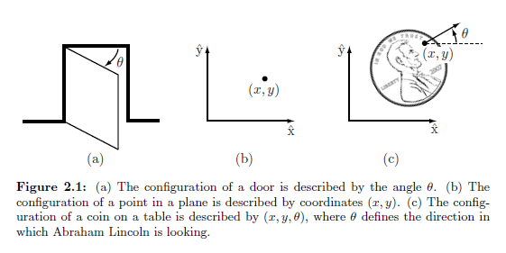
Simple Demonstration of dof

Slide 8
Defenition
The configuration of a robot is a complete specification of the position of every point of the robot. The minimum number n of real-valued coordinates needed to represent the configuration is the number of degrees of
freedom (dof) of the robot. The n-dimensional space containing all possible configurations of the robot is called the configuration space (C-Space).

Slide 9
Degrees of Freedom of a Rigid Body
A rigid body moving in three-dimensional space, which we call a spatial rigid body, has six degrees of freedom.
Similarly, a rigid body moving in a two-dimensional plane, which we henceforth call a planar rigid body, has three degrees of freedom.
degrees of freedom = (sum of freedoms of the bodies) - (number of independent constraints)

Slide 10
Joints
The revolute joint (R), also called a hinge joint, allows rotational motion about the joint axis.
The prismatic joint (P), also called a sliding or linear joint, allows translational (or rectilinear) motion along the direction of the joint axis.
The helical joint (H), also called a screw joint, allows simultaneous rotation and translation about a screw axis. Revolute, prismatic, and helical joints all have one degree of freedom. Joints can also have multiple degrees of freedom.
The cylindrical joint (C) has two degrees of freedom and allows independent translations and rotations about a single fixed joint axis.
The universal joint (U) is another two-degree-of- freedom joint that consists of a pair of revolute joints arranged so that their joint axes are orthogonal.
The spherical joint (S), also called a ball-and-socket joint, has three degrees of freedom and functions much like our shoulder joint

Slide 11
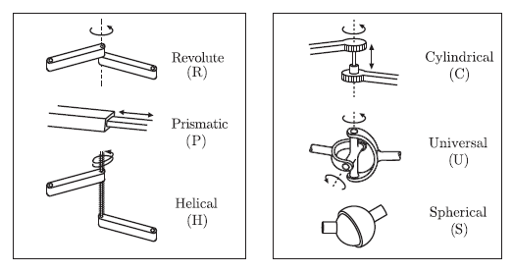
Robot Joints

Slide 12
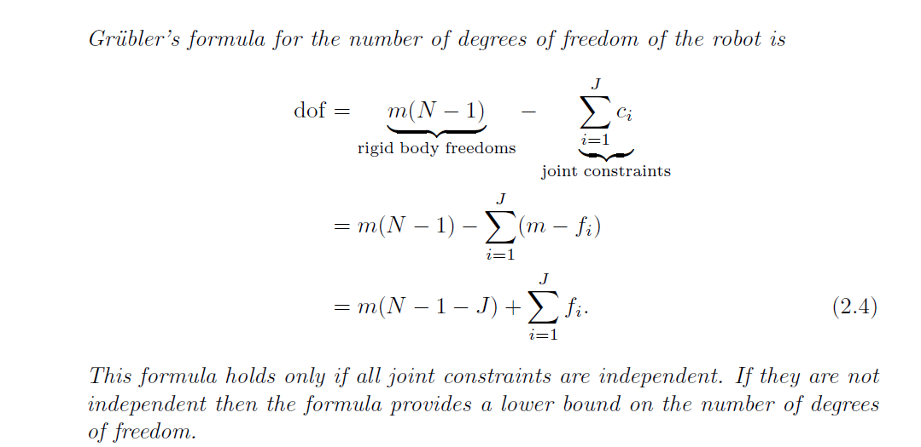
Grubler's Formula
The number of degrees of freedom of a mechanism with links and joints can be calculated using Grubler's formula.

Slide 13
m= degree of freedom for a single body
3 for planner bodies
6 for spatial bodies
N= NUMBER OF LINKS (by historical convention N includes ground as link)
J= NUMBER OF JOINTS
f = freedom of joint

Slide 14
The planar four bar linkage shown in (a) consists of four links (one of them ground) arranged in a single closed loop and connected by four revolute joints. Since all the links are connected to move in the same plane, we have m = 3.
Substituting
N = 4, J = 4, and fi = 1, i = 1; : : : ; 4, into Grubler's formula, we see that the four-bar linkage has one degree of freedom

Slide 15
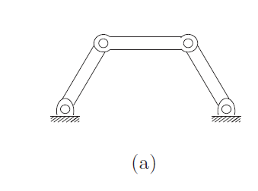
Grubler's formula can be applied to several planar and spatial mechanisms.
We distinguish between two types of mechanism: open-chain mechanisms (also known as serial mechanisms) and closed-chain mechanisms. A closed-chain mechanism is any mechanism that has a closed loop.
Example: Four-bar linkage (a)

Slide 16
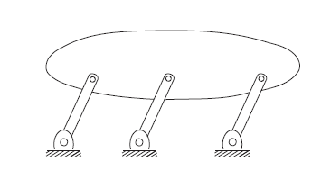
A parallelogram linkage
Dof of a parallelogram linkage

Slide 17
For the parallelogram linkage N = 5, J = 6, and fi = 1 for each joint. Grubler's formula, the number of degrees of freedom is
dof = 3(5 -1 -6) + 6 = 0.
A mechanism with zero degrees of freedom is by definition a rigid structure. It is clear from examining the figure, though, that the mechanism can in fact move with one degree of freedom. Indeed, any one of the three parallel links, with its two joints, has no effect on the motion of the mechanism, so we should have calculated.
dof = 3(4 -1- 4) + 4 = 1
In other words, the constraints provided by the joints are not independent, as required by Grubler's formula

Slide 18
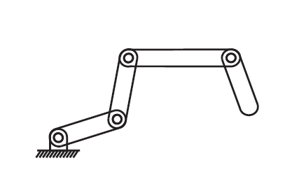
Exercise 1
Find the dof using Grubler’s formula

Slide 19
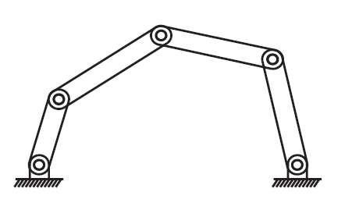
Exercise 2
Find the dof using Grubler’s formula

Slide 20
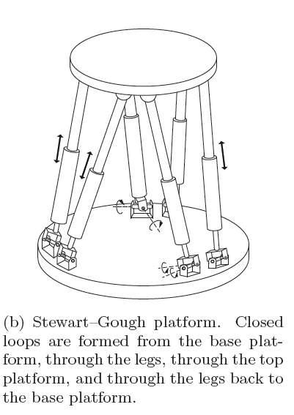
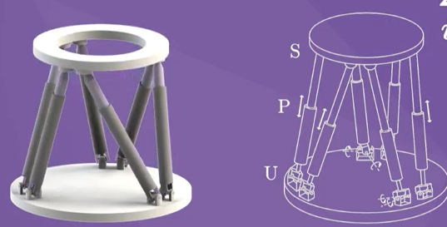
Stewart Gough platform.

Slide 21
The Stewart Gough platform consists of two platforms
the lower one stationary and regarded as ground, the upper one mobile connected by six universal prismatic spherical(UPS) legs. The total number of links is 14 (N = 14). There are six universal joints (each with two degrees of freedom, fi = 2), six prismatic joints (each with a single degree of freedom, fi = 1), and six spherical joints (each with three degrees of freedom, fi = 3). The total number of joints is 18. Substituting these values into Grubler's formula with m = 6 yields
dof = 6(14 -1 -18) + 6(1) + 6(2) + 6(3) = 6

Slide 22
Task Space and Workspace
The task space is a space in which the robot's task can be naturally expressed. For example, if the robot's task is to plot with a pen on a piece of paper, the task space would be R2. The decision of how to define the task space is driven by the task, independently of the robot.
The workspace is a specification of the configurations that the end-effector of the robot can reach. The definition of the workspace is primarily driven by the robot's structure, independently of the task.

Slide 23
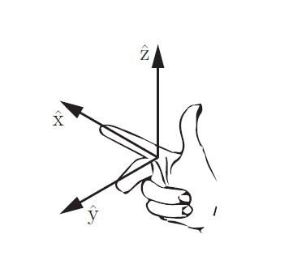
Frames
Rigid body representation on the space are represented using frames.
For simplicity, we will usually refer to a body frame as a frame attached to a moving rigid body. Despite this, at any instant, by body frame" we actually mean the stationary frame that is instantaneously coincident with the frame moving along with the body. All reference frames are right-handed

Slide 24
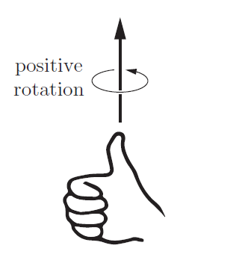
Rotation axis
A positive rotation about an axis is defined as the direction in which the fingers of the right hand curl when the thumb is pointed along the axis.

Slide 25
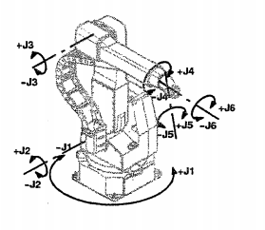
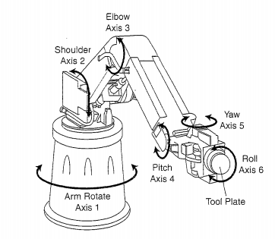
ROBOT AXES OF MOTION
Robot axes are also referred to as degrees of freedom. Each axis represents a degree of freedom; for example, a five-axes robot has five degrees of freedom.

Slide 26
REFERENCE FRAMES of Robots

Slide 27
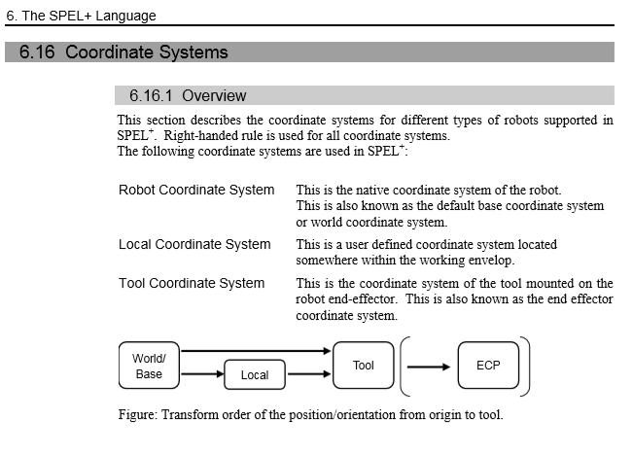
Overview on EPSON Robot Coordinate System

Slide 28
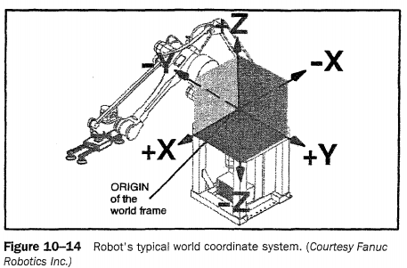
World Coordinate system
This section examines how the robot relates to its physical world. To do so, first imagine yourself sitting in a chair in a small room. The room represents your world coordinates. The fixed chair location establishes your right, left, front, back, up, and down. When a robot is fastened into its work cell, its world coordinates are established .This world coordinate system could also be called a world reference frame. A robot programmer can utilize the world reference plane in a program.

Slide 29
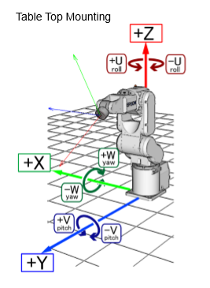
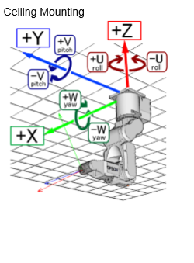
Six Axis Robot –Coordinate system

Slide 30
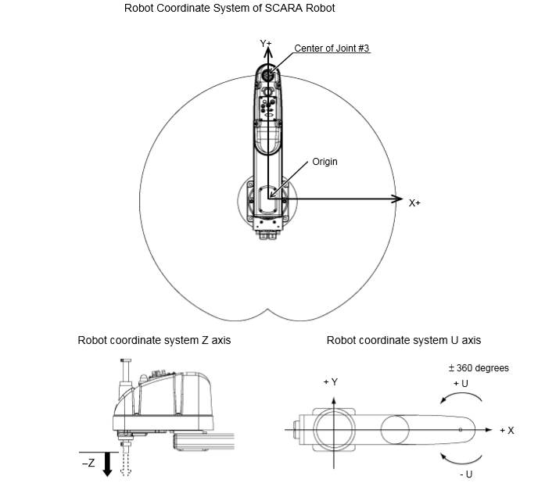
SCARA Robot–Coordinate system

Slide 31
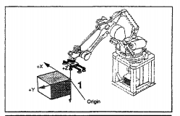
User Frame
The user would prefer to make the robot's x, y, and z correspond to the fixtures. A user who can make the x, y, and z of the robot correspond to the fixtures can utilize CAD data to program the robot. This also makes it easier to move the robot because a move in a x, y, or z plane now follows the fixtures axis instead of the robot's world frame. This transformation to a user reference frame is very easy to accomplish on many robots.

Slide 32
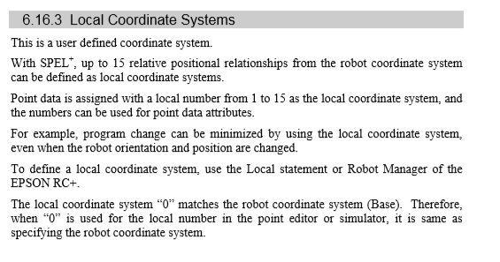
User frame in Epson Robot

Slide 33
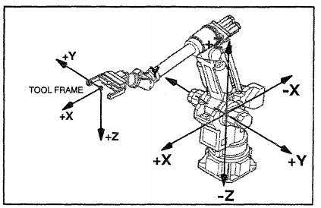
Tool Frame
Many robots can establish a tool frame. For example, in welding a circular shape, it is very important to keep the torch at the proper orientation to the weld as the robot moves the torch around the weld. A tool frame tells the robot what the tool's center point is. If this is not done; the robot control makes its calculations based on the robot's gripper face plate.

Slide 34
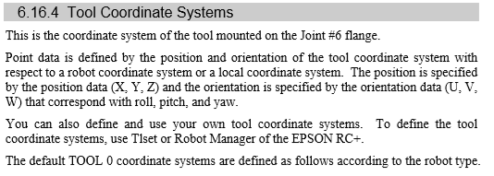
Tool Frame on Epson Robot

Slide 35
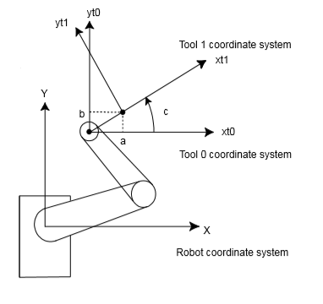
Tool Frame of SCARA Robot

Slide 36
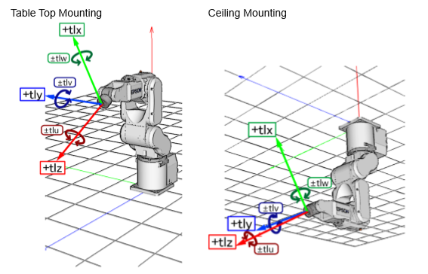
Tool Frame for 6-Axis Robot

